Slide 1

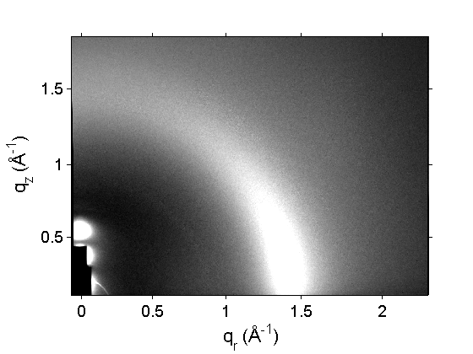
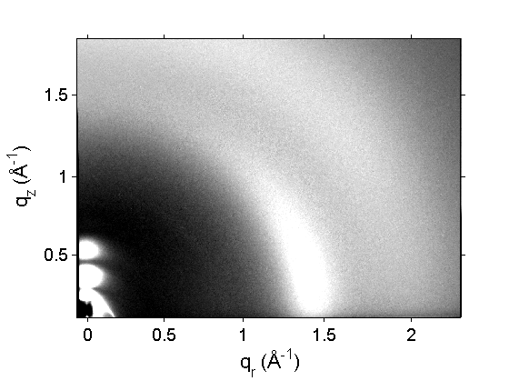
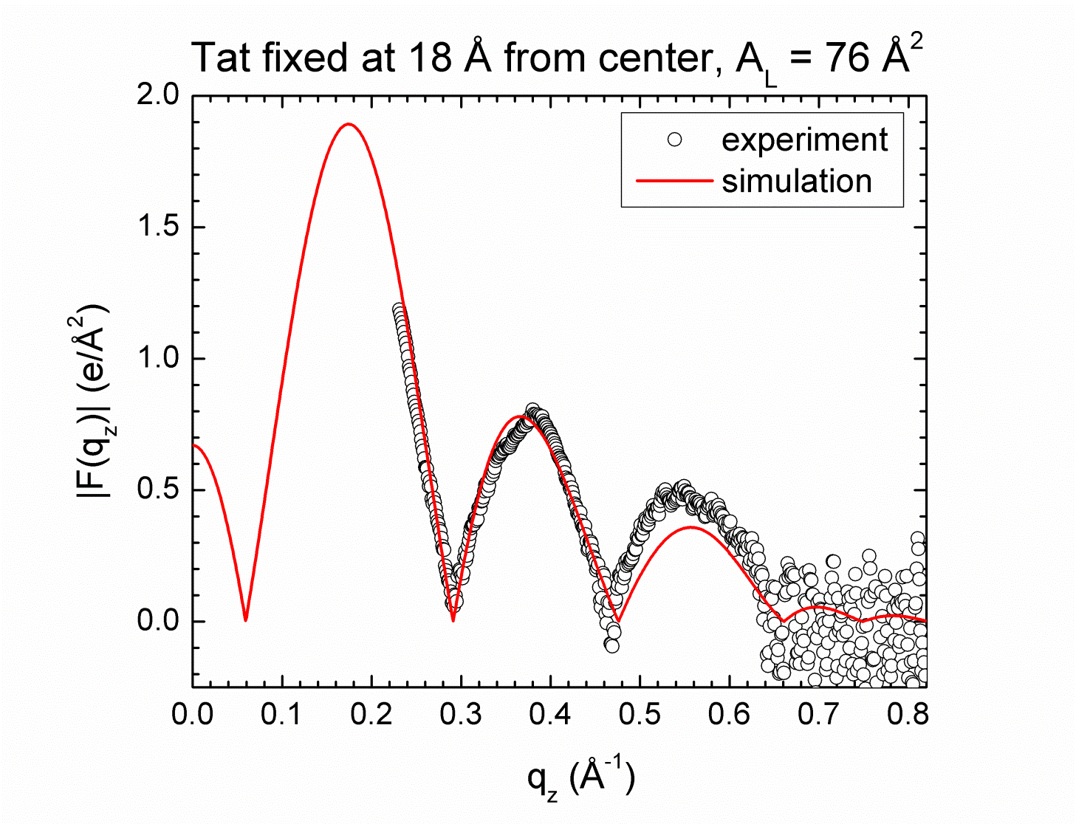
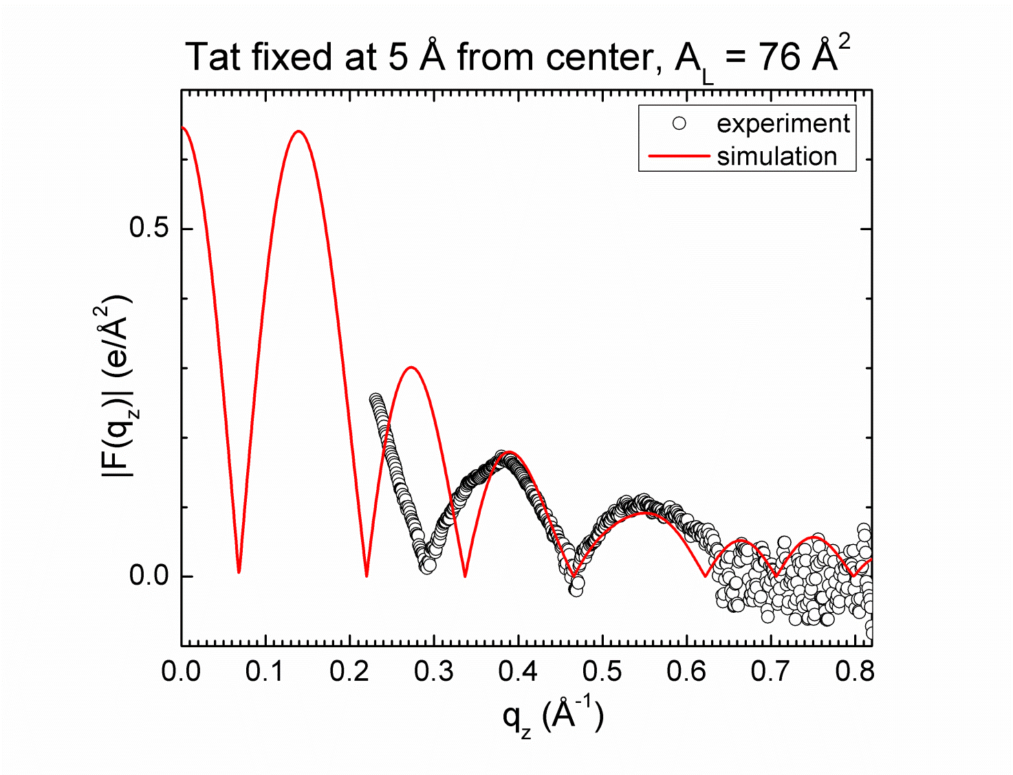
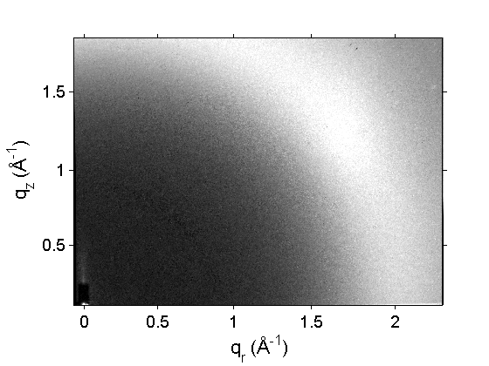
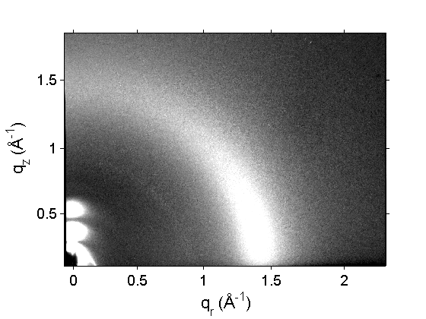
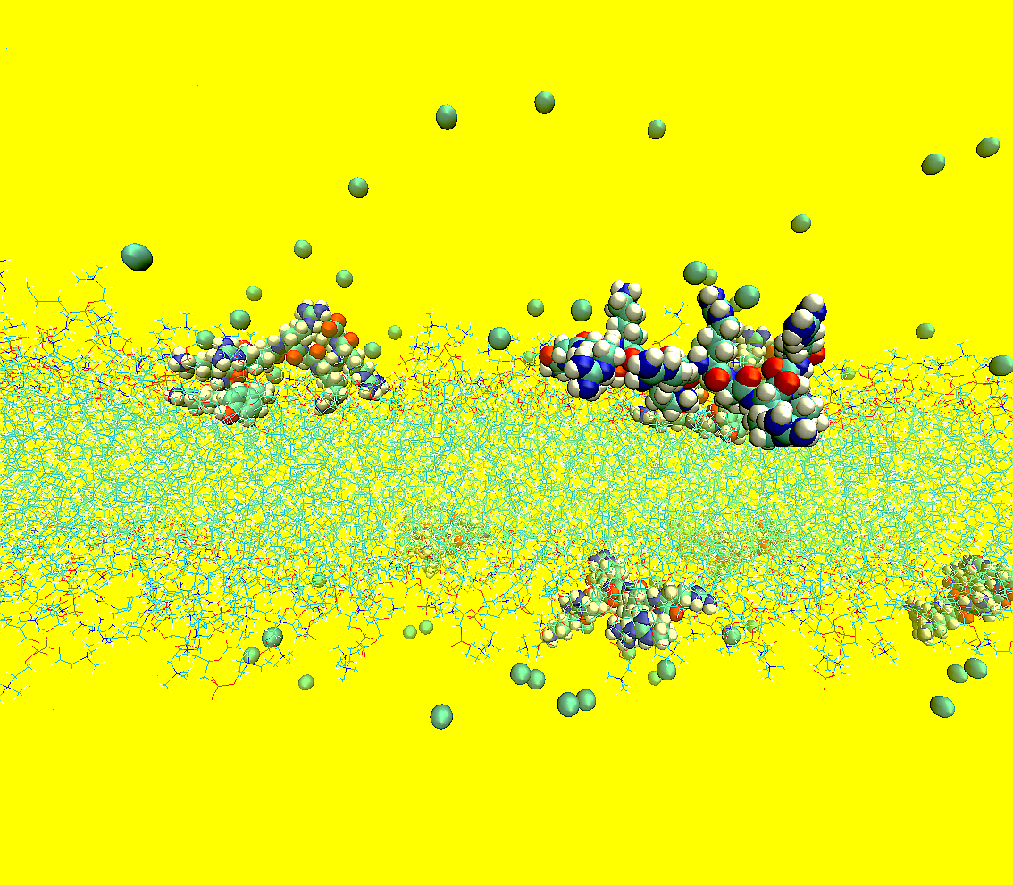
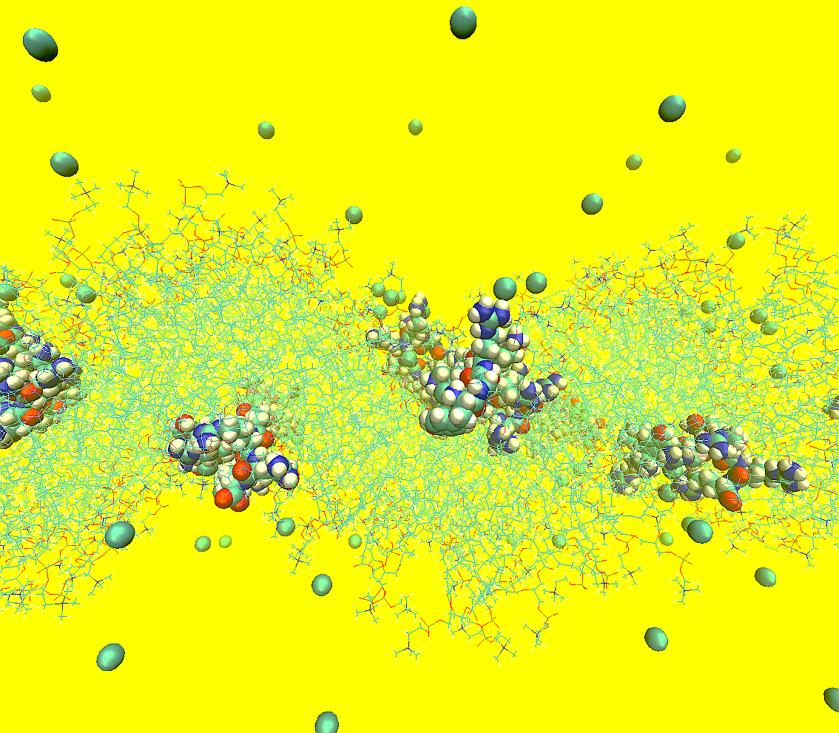
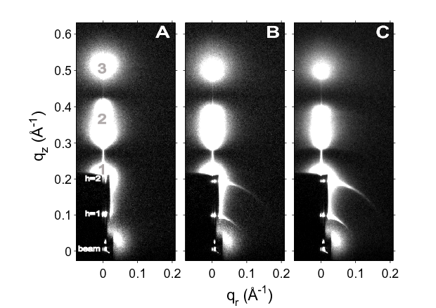
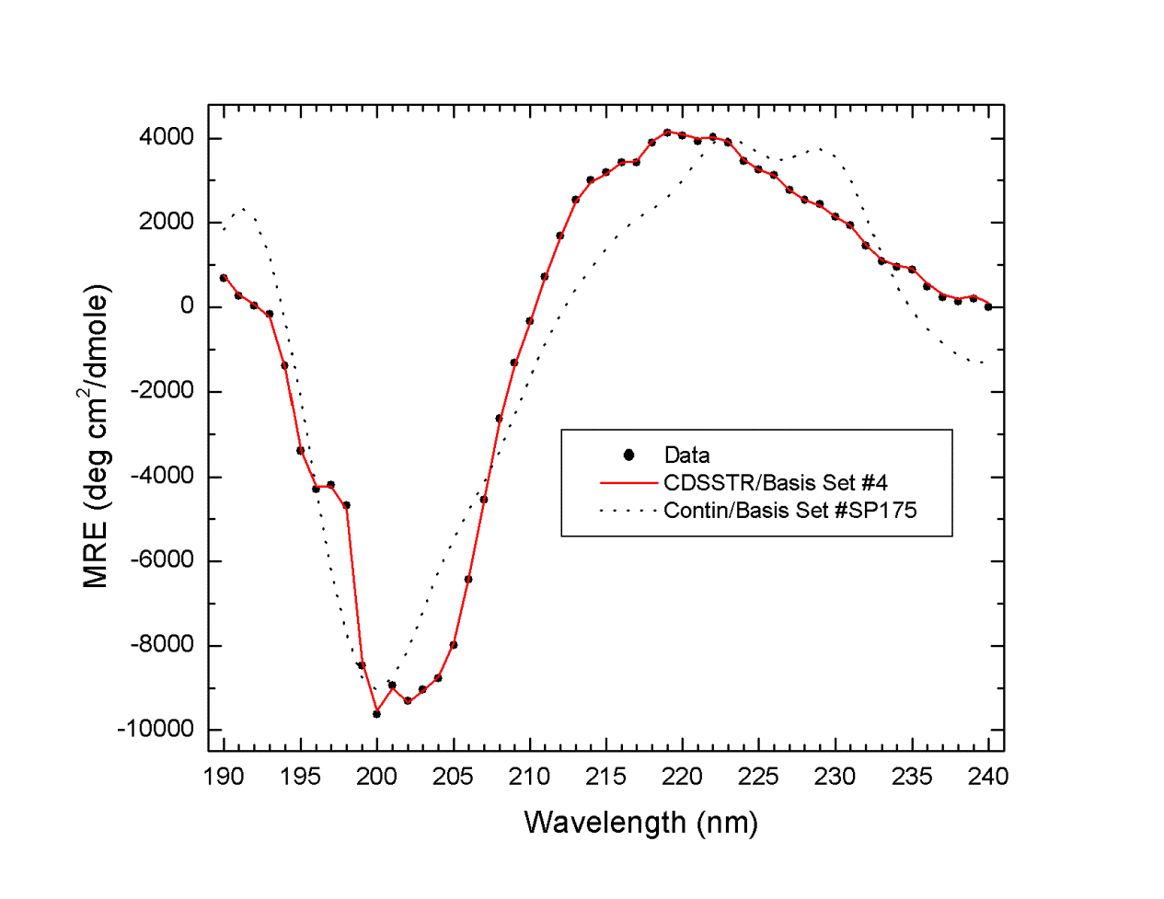
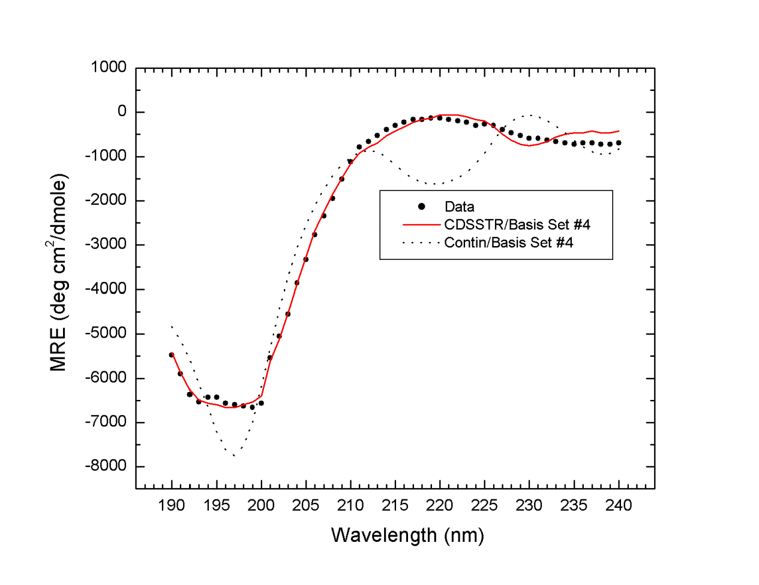
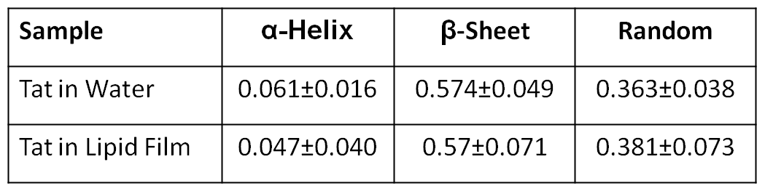
ABSTRACT: In an effort to understand membrane translocation of a cell-penetrating peptide, interactions of HIV-1 Tat peptide (YGRKKRRQRRR) with DOPC, DOPC/DOPE, DOPC/DOPS, and nuclear membrane mimics were investigated using low- and wide-angle x-ray scattering (LAXS and WAXS), neutron scattering, and circular dichroism (CD) spectroscopy. The diffuse scattering analysis applied to LAXS collected at CHESS revealed that Tat-membrane interactions reduce the membrane thickness by ~1 Å. In DOPC and DOPC/DOPE membranes, the position of Tat was found to transition from the vicinity of the glycerol-carbonyl headgroup to the phosphate headgroup as Tat mole fraction was increased from 0.009 to 0.06. The area per lipid for DOPC and DOPC/DOPE membranes increased by ~2 Å² at the highest Tat mole fraction. The membrane bending modulus was found to decrease by roughly a factor of 2 at the highest Tat mole fraction except for the nuclear mimic. The chain-orientational order parameter, Sxray, calculated from WAXS and corrected for mosaic spread, showed Tat slightly disordered chains. Neutron scattering collected at NIST from fully hydrated samples consisting of DOPC/DOPE (3:1) membranes and Tat at 0.06 mole fraction showed a prominent, broad peak corresponding to a Tat-membrane correlation of ~100 Å. The secondary structure of Tat calculated from CD spectra using DichroWEB was found to be the same in pure water as in lipid thin films and primarily consisted of β-sheet and random coil with small helical content. Our findings are consistent with the results from MD simulations by Herce and Garcia, which suggested that Tat interacts with phosphate headgroups across the bilayer, facilitating the formation of pores. The ensemble of configurations obtained from a new MD simulation allows visualization of Tat/membrane interactions. Funded by GM44976, GM86801, DMR-0936384(CHESS), and DOE(NIST).
HIV-1 TAT MEMBRANE TRANSLOCATION PROBED BY LOW- AND WIDE-ANGLE X-RAY SCATTERING, NEUTRON SCATTERING, CD SPECTROSCOPY AND MD SIMULATIONS
Kiyotaka Akabori¹, Bradley Treece¹, Michael S. Jablin¹, John F. Nagle¹, Brian Maranville², Kun Huang³, Angel Garcia³ and Stephanie Tristram-Nagle¹
¹Physics Department, Carnegie Mellon University, Pittsburgh, PA, 15213, ²NIST Center for Neutron Research, Gaithersburg, MD 20899, ³Physics Department, Rensselaer Polytechnic Institute, Troy, NY 12180, USA
I. Introduction
Tat, the transactivator of translation from HIV-1, is efficiently taken up by cells and cell nuclei.
It has been reported that cell uptake does not require ATP¹
YGRKKRRQRRR is the part of the Tat protein responsible for uptake; deletion of 3 out of the 8 positive charges causes the loss of the ability to translocate¹. This is the peptide in this work.
The uptake appears to require PS and/or PE in addition to PC lipids in GUV experiments².
Tat may form a transient pore, such as seen in MD simulations³, that may then allow larger molecules, such as proteins and DNA, to enter a cell.
We probe Tat’s effect on membrane structure and elasticity in an attempt to elucidate the mechanism of Tat’s translocation.
¹Vives et al., JBC 272:16010 (1997); ²Ciobanasu et al., BJ 99:153 (2013); ³Herce and Garcia, PNAS 104:20805 (2007).
IV. Comparison of X-ray form factors with MD simulations
VI. WAXS, Sxray
IX. Summary of results
A B
C D
Tat thins membranes.
Tat is located in the headgroup region.
By comparing our X-rays results to MD simulations, there is evidence against Tat’s location near the center of the bilayer.
Tat causes a decrease in KC, which lowers the energy to bend the membrane inwards to form a pore.
Tat disorders lipid chains, which could rearrange more easily to form a pore.
Tat is primarily β-sheet in solution and in the membrane.
Neutron and X-ray scattering did not demonstrate in-plane Tat aggregation.
At high hydration, Tat increases mosaic spread which is reversible by dehydrating the sample.This membrane misorientation could lead to local defects.
Model Bilayers
DOPC
DOPC/DOPE (3:1)
DOPC/DOPE (1:1)
DOPC/DOPS (3:1)
Nuclear Mimic: POPC/POPE/POPS/SoyPI/Chol (69:15:2:4:11)
Figure 3. The SIMtoEXP software compares form factors calculated from MD simulations (red) with our X-ray data (black open circles). Good agreement between simulation and experiment is obtained with Tat in the headgroup position, but NOT with Tat deep in the hydrocarbon interior.
Figure 7. Wide angle X-ray scattering (WAXS) with A. no excess water, B. excess water, C. water only, D. water removed (B – fC).
II. LAXS and bending modulus, KC
Do these structural and elastic results lead to a mechanism for pore formation?
Figure 4. MD simulations of DOPC with 3 mole% Tat (4 Tat/128 DOPC) using Gromacs force field with Area/unit cell = 76 Å² . Center-of-mass of Tat is fixed at 18 Å (left) or 5 Å (right) from bilayer center.
Figure 8. Sxray decreases with increasing Tat; Tat disorders chains.
VII. Mosaic spread
Figure 9. X-ray diffuse scattering of DOPC/DOPE (1:1), x=0.03 Tat shows elongation of arcs on lamellar orders with hydration. D-spacing = A. 60.6 Å, B. 65.4 Å, C. 65.3 Å.
Figure 2. Bending modulus, KC, vs. x=P/(L+P) mole fraction. Estimated uncertainty in all values is ± 2. In all mimics, KC decreased with increasing Tat mole fraction, indicating a softening of lipid membranes.
Figure 1. Low angle X-ray scattering (LAXS) from fully hydrated, oriented bilayers of
DOPC/DOPE (1:1), x=0.034 Tat at 37 °C. Lamellar D-spacing = 60.6 Å.
III. X-ray form factors
Figure 3. Form factors from X-ray diffuse data show a shift towards higher qz with increasing Tat, indicating bilayer thinning for every mimic.
Mimics are: A. DOPC, B. DOPC/DOPE (3:1), C. DOPC/DOPE (1:1), D. DOPC/DOPS (3:1), E. Nuclear mimic.
X. Conclusions
Figure 10. Neutron scattering of DOPC:DOPE (3:1), x= 0.059 Tat shows loss of misorientation as the sample is dried. D-spacing = A. 63.7 Å, B. 57.6, C. 49.1 Å, indicating a reversible hydration-induced mosaic spread in the Tat samples.
Our results show that Tat remains as a β-sheet near the membrane surface. Since it thins membranes, increases bending, disorders and misorients layers, we suggest that local deformations at high hydration may occur as shown above. Translocation may occur through these defects, but our results do not support an equilibrium, interior Tat position, nor an interior position of phosphate headgroups.
Figure 5. Results from MD simulations (blue) show a decrease in bilayer thickness (DHH (head-to-head) and DPP (phosphate-to-phosphate)) and an increase in the Tat position with increasing concentration. AL also increases with Tat. These results are similar to those obtained with the SDP model fitting program used with the X-ray data (black, red and green).
VIII. CD Spectroscopy
V. X-ray electron density profiles
A B
Methods: Pure lipids purchased from Avanti Polar Lipids and Tat peptide purchased from the Peptide Synthesis Facility at the University of Pittsburgh were oriented onto silicon substrates using the rock and roll method (Tristram-Nagle, Methods in Molecular Biology, 400:63, Humana Press, 2007). The membranes are hydrated through the vapor in a thick-walled hydration chamber that achieves full hydration (same D-spacing as excess water in capillary) and X-rayed at the CHESS synchrotron (Cornell). Raw data images are collected on a CCD. The diffuse LAXS data, caused by thermal fluctuations, were analyzed using liquid crystal theory (Lyatskaya et al., Phys. Rev. E 63:011907 (2001)). Oriented samples give the best data for high qZ, and they also give the bending modulus Kc. WAXS was obtained at grazing angle of incidence on the same hydrated, oriented samples. Similar samples were prepared for neutron scattering at NIST where ten samples in a stack, hydrated through the vapor in a newly fabricated hydration chamber, were irradiated simultaneously with angle of incidence=2.46º and the scattered neutrons were collected on a Denex 2D detector. CD of Tat in membranes was collected from a hydrated Tat/lipid film, purposely misoriented to avoid orientation effects. CD analysis was done using DichroWEB and protein basis sets.
Figure 6. Electron density profiles from X-ray data. A. Component groups with a shaded Tat Guassian. B. Tat in DOPC. C. Tat in DOPC/DOPE (3:1). D. Tat in DOPC/DOPE (1:1). Thicknesses, area and Tat position are quantitated in Fig. 5 (above).
Figure 11. CD spectroscopy of A. Tat in water and B. Tat in DOPC/DOPE (3:1), x=0.108. In both cases, Tat is primarily β-sheet.
Acknowledgments: Funding from NIH GM 44976. Beam time from CHESS (NSF DMR-0225180) and NIST (Dept. of Commerce).
For more information see http://www.cmu.edu/biolphys/jfstn

